Slide 1
JavaScript

Slide 2
JavaScript Objects
In JavaScript, objects are data (variables), with properties and methods.
In JavaScript you can also create your own objects.
This example creates an object called "person", and adds four properties to it:
Example
var person = {firstName:"John", lastName:"Doe", age:50, eyeColor:"blue"};
Accessing Object Properties
name = person.lastName; name = person["lastName"]; Accessing Object Methods
name = person.fullName();

Slide 3
JavaScript Scope
Local JavaScript Variables
Variables declared within a JavaScript function, become LOCAL to the function.
Local variables have local scope: They can only be accessed within the function.
Example
// code here can not use carName function myFunction() { var carName = "Volvo"; // code here can use carName }
Global JavaScript Variables
A variable declared outside a function, becomes GLOBAL.
A global variable has global scope: All scripts and functions on a web page can access it.
Example
var carName = " Volvo"; // code here can use carName function myFunction() { // code here can use carName }

Slide 4
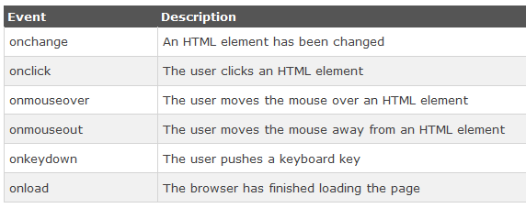
JavaScript Events
JavaScript can react to these HTML events:
An HTML web page has finished loading
An HTML input field was changed
An HTML button was clicked

Slide 5
JavaScript Conditional Statement
Syntax
if (condition1) { block of code to be executed if condition1 is true } else if (condition2) { block of code to be executed if the condition1 is false and condition2 is true } else { block of code to be executed if the condition1 is false and condition2 is false }

Slide 6
JavaScript for Loop
for (initialization; condition; increment/decrement) { code block to be executed }
var i;
for (i = 0; i < 5; i++) {
document.write("The number is " + i + "<br>”);
}

Slide 7
JavaScript while Loop
while (condition) { code block to be executed }
while (i < 10) { document.write("The number is " + i); i++; }

Slide 8
Reference
Chapter 4 of WEB TECHNOLOGIES: A Computer Science Perspective by Jeffrey C. Jackson

Slide 9
Assignment (Optional)
Create a web-based calculator using JavaScript and other necessary tools.
Submission Deadline: Next Lab
Email to bijon_sust@yahoo.com mention Your student ID in the subject line

